Slide 1

Friend Function Copy constructor
Lecture 6

Slide 2
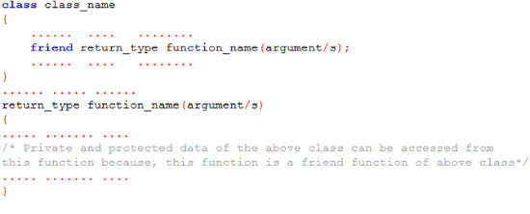
Friend Function
A friend function is a function that is not a member of a class but has access to the class's private and protected members. Friend functions are not considered class members; they are normal external functions that are given special access privileges.

Slide 3

Programming Example:
#include <iostream>
using namespace std;
class Distance
{
private:
int meter;
public:
friend int func(Distance d);
};
int func(Distance d)
{
d.meter=5;
return d.meter;
}
int main()
{
Distance D;
cout<<"Distace: "<<func(D);
return 0;
}

Slide 4
Friend Function Example
#include <iostream>
using namespace std;
class Box
{
double width;
public:
friend void printWidth( Box box );
void setWidth( double wid );
};
// Member function definition
void Box::setWidth( double wid )
{
width = wid;
}
void printWidth( Box box )
{
cout << "Width of box : " <<
box.width <<endl;
}
int main( )
{
Box b;
b.setWidth(10.0);
printWidth( b);
return 0;
}
Output:
Width of box : 10

Slide 5
What are the characteristics of friend functions?
A friend function is not in the scope of the class in which it has been declared as friend.
It cannot be called using the object of that class.
It can be invoked like a normal function without any object.
Unlike member functions, it cannot use the member names directly.
It can be declared in public or private part without affecting its meaning.
Usually, it has objects as arguments.

Slide 6
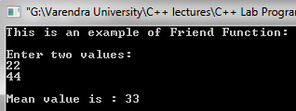
Programming Example
#include<iostream>
using namespace std;
class base
{
int val1,val2;
public:
void get()
{
cout<<“This is an example of Friend Function:” ;
cout<<“Enter two values:\n”;
cin>>val1>>val2;
}
friend float mean(base ob);
};
float mean(base ob)
{
return float(ob.val1+ob.val2)/2;
}
main()
{
base obj;
obj.get();
cout<<"\nMean value is : "<<mean(obj);
}

Slide 7
Friend Classes
It is possible for one class to be a friend of another class. When this is the case, the friend class and all of its member functions have access to the private members defined within the other class. For example,
#include <iostream>
using namespace std;
class TwoValues {
int a;
int b;
public:
TwoValues(int i, int j) { a = i; b = j; }
friend class Min;
};
class Min {
public:
int min(TwoValues x);
};
int Min::min(TwoValues x)
{
return x.a < x.b ? x.a : x.b;
}
int main()
{
TwoValues ob(10, 20);
Min m;
cout << m.min(ob);
return 0;
}

Slide 8
Copy constructor
Copy constructor is a constructor which creates an object by initializing it with an object of the same class, which has been created previously.
The copy constructor is used to:
Initialize one object from another of the same type
Copy an object to pass it as an argument to a function
Copy an object to return it from a function

Slide 9
If a copy constructor is not defined in a class the compiler itself defines one (default copy constructor).
If the class has pointer variables and has some dynamic memory allocations, then it is a must to have a copy constructor.
It must make a deep copy with an explicitly defined copy constructor
Common form of copy constructor is shown here:
classname ( classname &obj)
{
// body of constructor
}

Slide 10
copy constructor Example
class Example {
int a,b;
public:
Example(int x,int y) {
a=x;
b=y;
cout<<"\nIm Constructor";
}
void Display() {
cout<<"\nValues :"<<a<<"\t"<<b;
}
};
int main() {
Example Object(10,20);
//Copy Constructor
Example Object2=Object;
// Constructor invoked.
Object.Display();
Object2.Display();
return 0;
}

Slide 11
copy constructor Example
#include <iostream>
using namespace std;
class cc
{
int a;
public:
cc(int x){
a=x;
}
void show(){
cout<<"a="<<a<<endl;
}
cc(cc &o){
a=o.a;
}
};
int main( )
{
cc ob(100);
cc ob1(ob);
ob.show();
ob1.show();
}

Slide 12
Deep Copy
#include <iostream>
using namespace std;
class A{
private:
int *x;
public:
A(int p){
x=new int;
*x=p;
}
A( A & obj)
{
x = new int;
*x = *(obj.x);
}
void set(int m){
*x=m;
}
void show(){
cout<<*x<<endl;
}
};
int main()
{
A ob(10);
A ob1=ob;
ob.show();
ob1.show();
ob1.set(20);
ob.show();
ob1.show();
return 0;
}

